Slide 1

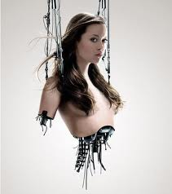
Level 6
Artificial Intelligence

Slide 2

Introduction
About the course
Develop some interest
Propose some definitions
Answer some questions
I hope it is not very boring !!!

Slide 3
About The Course
Learning Outcomes:
have a sound grasp of logic as a representation and reasoning strategy for AI
be proficient in the use of the PROLOG programming language
have a comprehensive understanding of other presentation and reasoning techniques including Procedural, Network, Structure, Temporal, etc.

Slide 4
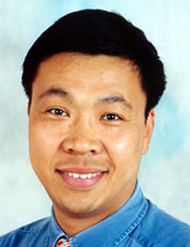
About The Course
Lecture/Tutor
Dr Jixin Ma
Room: QM405
Tel: 02083318539
E-mail: j.ma@gre.ac.uk

Slide 5
About The Course
Time/Day
Lecture: 18:00 - 20:00 Tuesday
Tutorial/Laboratory: 20:00 - 21:00 Tuesday
Location
Lecture: KW216
Tutorial/Lab: KW102

Slide 6
About The Course
Assessment Details
Coursework Only 100%

Slide 7
About The Course
Requirements
You MUST
  Attend Lecture/Tutorial/Laboratory
  Complete Coursework

Slide 8
About The Course
Recommended Textbooks
Artificial Intelligence, by R. Callan, Palgrave Macmillan, 2003, ISBN: 0-333-80136-9
Artificial Intelligence, by E. Rich and K. Knight, McGraw-Hill, 1991, ISBN: 0-07-052263-4
PROLOG Programming for Artificial Intelligence, by I. Bratko, third edition, Addison-Wesley, 2001, ISBN: 0-201-40375-7

Slide 9
Two distinct methods of learning
PASSIVE
The lecturer serves up the material
Solves any problems
You lean back and observe

Slide 10
Two distinct methods of learning
ACTIVE
You prepare for your lectures and tutorials beforehand
You work out what the problems are
You ask questions to understand the work

Slide 11


Don’t be SHY!!!
Don’t keep quiet
if you don’t understand
or can’t do the questions.
?????

Slide 12
What is AI ???
Systems that think like humans?
Systems that think rationally?
Systems that act like humans?
Systems that act rationally?

Slide 13
Then, what is the definition?
AI is the design and study of computer programs/systems that behave intelligently.
AI programs are constructed to carry out, mainly, cognitive tasks that can be intelligently and most unconsciously done by human beings

Slide 14
Some Relevant Questions
        What is Intelligence?
        What is Creativity?
        What is Intuition?
        How do we represent Knowledge?
        How do we reason and learn?
        Do we inherit or acquire Intelligence?

Slide 15
AI Disciplines
  Learning
  Knowing
  Reasoning
  Solving
Game Playing
Machine Learning
Knowledge Representation
Commonsense Reasoning
Expert Systems
Neural Networks
Genetic Algorithms

Slide 16
AI Disciplines
TO BE OR NOT TO BE,
THAT IS THE QUESTION
Seeing
Hearing
Talking
Computer Vision
Natural Language Understanding
Semantic Modeling,
Translation

Slide 17
AI Disciplines
Moving
Holding
Doing
Robot

Slide 18
Machine Learning
Definition & Purpose
Stupid
Machine !
When is a machine said to be learning?

Slide 19
Machine Learning
Applications
Rules from examples
Profiles & Patterns from data
Predictive Models

Slide 20
Expert Systems
Definition & Purpose
Capturing & Replaying Knowledge

Slide 21
Expert Systems
Applications
Automation
Diagnosis
Design
Plan
Assessment
Advice

Slide 22
Neural Networks
Definition & Purpose
Mimicking the Human Brain
Parallelism
w₁ w₂ w_{n}
x₁ x₂ x_{n}

Slide 23
Neural Networks
Applications
Credit Card Fraud - VISA International
Learning to Talk
Marketing Profiles
Pattern Recognition
Granting Credit
OH ..
SHUT UP !!
Da Da

Slide 24
Genetic Algorithms
Definition & Purpose
Theory of Evolution
Mating of Solutions
Survival of the Fittest
Improvement by Mutation
Don’t we have lovely
children dear? apart
from... you know!!

Slide 25
Genetic Algorithms
Applications
Finding Approximate Solutions
Travelling Salesman
15 Cities : 1,307,674,368,000
Scheduling of Production
Synthesis Problems
Tile fitting
Ingredient mixing

Slide 26
Natural Language Understanding
Definition & Purpose
Understanding Human Language
Complexity and Limitations
agent
give
object
Person:Mary
Person:John
recipient
Book
Mary gave John the Book

Slide 27
Summary
Problem
Solving
Robotics
Control
Machine
Learning
Natural
Language
Artificial
Intelligence
Expert
Systems
Genetic
Algorithms
Knowledge Representation /
Commonsense Reasoning
Neural
Networks

Slide 28
Artificial vs. Human
Intelligence
AI by far Inferior
Why?
Background Knowledge
    Search Approach
    Imprecise and Fuzzy Logic
    Physical Abilities
    Senses
YOU WIN

Slide 29
What is the future of AI
More Speed
More Power
More Integration
More Cost Reductions
Is this what’s required though? May be not !!

Slide 30
Knowledge Representation
and Reasoning in AI

Slide 31
Knowledge Representation
Knowledge plays an vital role in:
Understanding language;
Recognising objects;
Interpreting situations;
Making decisions;
Planning strategies;
etc.

Slide 32
Knowledge classification (1)
According to what it tells:
Declarative knowledge -- this type of knowledge tells what things are or what they do.
E.g.: Mary is female.
  Mary loves her mother.
Procedural knowledge -- this type of knowledge tells how to do things.
E.g.: To get a driving licence, one has to learn driving skills as
well as traffic rules, and to pass driving test.

Slide 33
Knowledge classification (2)
According to its applied area:
Domain-specific knowledge -- this type of knowledge is only on some given particular subject, i.e., it is relevant only in a restricted domain (domain-dependent).
E.g.: Marilyn Monroe died in 1962.
Common-sense knowledge -- this type of knowledge applies throughout our experience (domain-independent).
E.g.: Everybody would eventually die.

Slide 34
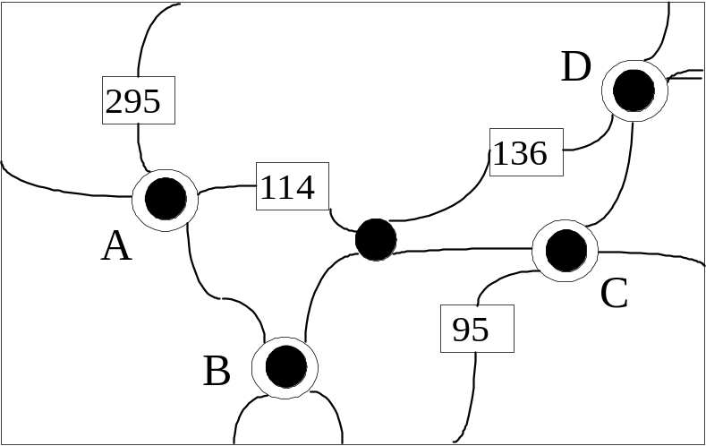
Presentation - the notion
The notion of a representation is general, and hence, somewhat elusive. Different representations can be employed to describe complex objects.
E.G.: A road map;
A computer-aided-design (CAD) model;
An integrated circuit layout.

Slide 35
Representation -
Syntax and Semantics (1)
Representation =
notation + denotation + computation
Notation/Syntax
Notation refers to the appropriate conventions for writing things down. As for the road-map example, this component corresponds to the graphical conventions for displaying motorways and cities.
We often use the term syntax to refer to the notational conventions associated with a given representation. It specifies the objects of discourse and a language for relating them to one another.

Slide 36
Representation -
Syntax and Semantics (2)
Representation =
notation + denotation + computation
Denotation/Semantics
Denotation refers to the meaning of the objects and relations specified in the syntax. In the road-map example, the denotation corresponds to the interpretation of the marks on a road map as actual cities and motorways.
We often use the term semantics to refer to the denotational conventions associated with a given representation.

Slide 37
Representation -
Syntax and Semantics (3)
Representation =
notation + denotation + computation
Computation
This component refers to the computational model which specifies how the objects and relations are manipulated in accord with the semantical conventions.

Slide 38
Assessing Metrics of
Representations (1)
Expressiveness
Effectiveness
Efficiency
Explicitness

Slide 39
Assessing Metrics of
Representations (2)
Expressiveness
A good representation scheme should be characterised by completeness and clarity of expression:
being able to handle different types and levels of
  granularity of knowledge;
being able to represent complex knowledge and
  knowledge structures and the relationships
  between them;
having means of representing specific facts and
  generic information;
being natural and usable

Slide 40
Assessing Metrics of
Representations (3)
Effectiveness
A good representation scheme should provide a means of inferring new knowledge from old, and be amenable to computation, allowing adequate tool support.

Slide 41
Assessing Metrics of
Representations (4)
Efficiency
A good representation scheme must not only support inference of new knowledge from old but must do so efficiently in order for the new knowledge to be of use. Also, it should facilitate efficient knowledge gathering and representation.

Slide 42
Assessing Metrics of
Representations (5)
Explicitness
A good representation scheme should be able to provide an explanation of its inferences and allow justifications of its reasoning. The chain of reasoning should be explicit.

